Slide 1
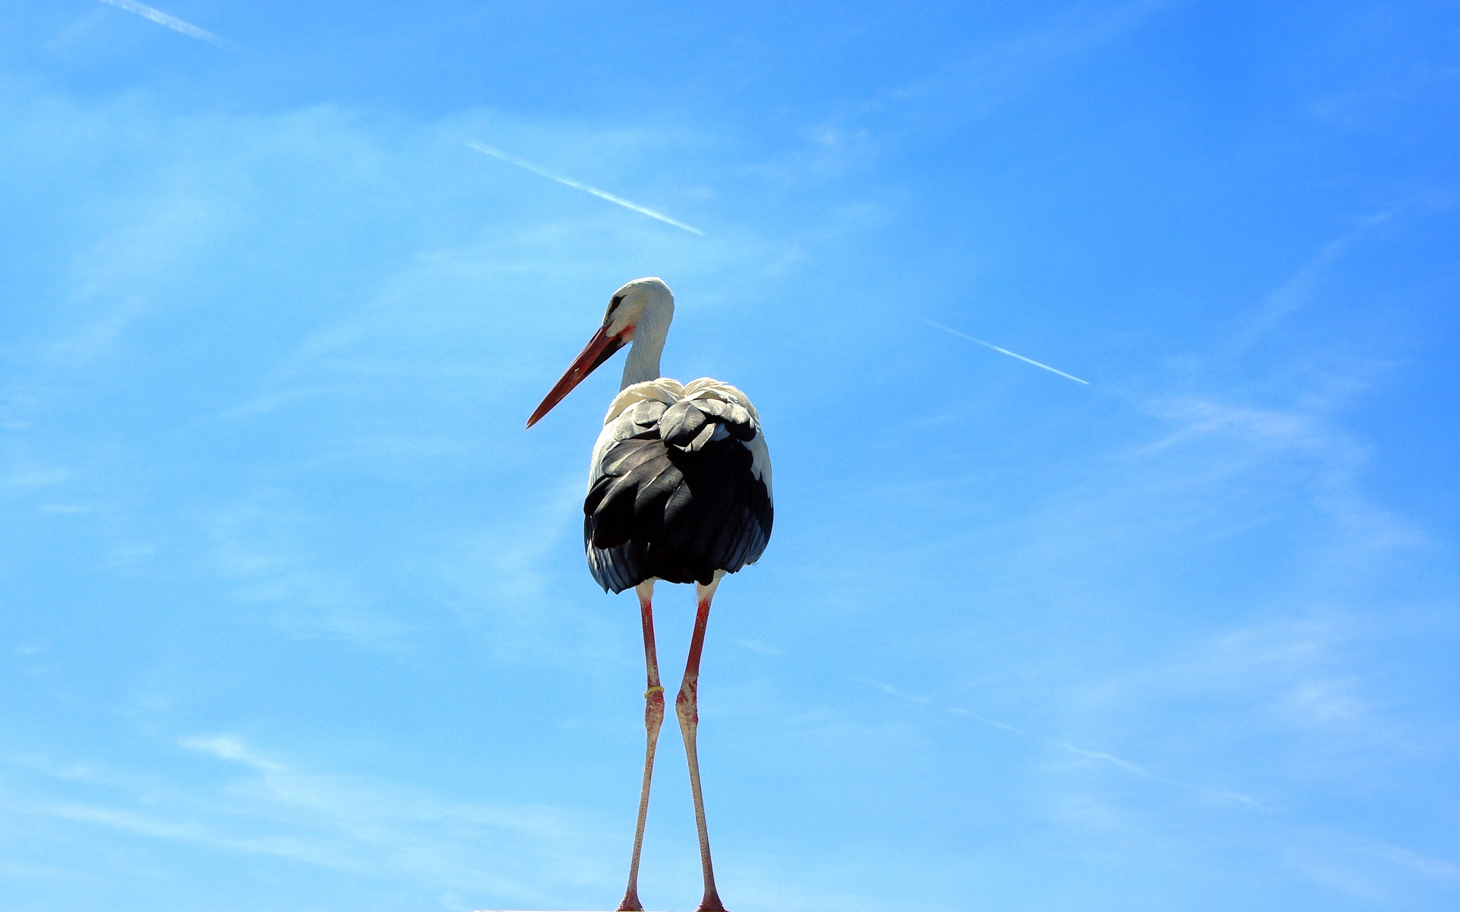
FINAL TOUCHES TO THE FINAL EXHIBITION
BQ5 Creativity Lesson 3
I have understood and applied the feedback from my teacher to my final exhibition
Notes:
See how this lesson links to the course by viewing the final slide
Key TOK terms appear in a red font

Slide 2
Starter
Find the shared feedback form.
What do you have to share with your teacher?

Slide 3
The feedback process - part 1
In the first three columns of the shared feedback form, add your name, IA prompt that you have chosen, and the three objects that you have selected.
Share your draft exhibition commentary with your teachers. If you haven’t quite finished this, you’ll have this lesson to do so.
Think of a title for your exhibition. This should ‘clearly indicate’ your IA prompt.

Slide 4
The feedback process - part 2
Your teacher will give you feedback for you to put the finishing touches to your exhibition. This will be based on the four assessment strands:
Identifying a clear real-world context for your objects
Clearly linking the objects to an IA prompt
Justifying why you chose your objects
Supporting your points with evidence
Check your two practice presentations to help you understand this.

Slide 5
What makes your exhibition uniquely yours?
Notes:
See the BQ5 assessment tracker for suggestions on providing feedback, and recording students’ progress.

Slide 6
Linking this lesson to the course
During this lesson, we consider the highlighted aspects of the TOK course
The images used in the presentation slides can also give students ideas about selecting exhibition objects; see also our link below to specific IA prompts
CORE THEME | OPTIONAL THEMES | AREAS OF KNOWLEDGE | TOK ASSESSMENT
Knowledge & the knower | Indigenous societies | The arts | The TOK essay
 | Language | History
 | Politics | The human sciences | The TOK exhibition This lesson gives general exhibition advice, so doesn’t link to specific prompts
 | Religion | Mathematics
 | Technology | The natural sciences

Slide 7
Explore the TOK themes and areas of knowledge in more depth via a range of thinkers, media sources, and other resources, in our EXPLORATION POINTS DOCUMENTS.
Access the documents via the links below. You’ll also find the EP icons on all of the TOK course pages of the site to help you unpack the quotes, KQs, and real-life situations that you find there.
CORE THEME
Knowledge & the knower
OPTIONAL THEMES
Indigenous societies
Language
Politics
Religion
Technology
AREAS OF KNOWLEDGE
The arts
History
Human sciences
Mathematics
Natural sciences
Notes:
Use this slide to access the ‘Exploration Points’ notes for BQ5, which will help students to develop a deeper knowledge of any TOK theme or area of knowledge. This will not only help them to master the TOK course in general, but also craft a great exhibition or essay.
Be ready to provide more guidance on how to use this resource - ie, which media sources to focus on, which questions to address, which TED talks to watch, and which key terms and ideas to understand.

